Slide 1
Title goes here

Slide 2
Learning objectives for this presentation:
Paste the objectives here.
Make sure they all have full stops.
Make sure they all start with an imperative verb.
The box is H: 1cm and V: 4cm.

Slide 3
Content slide
All text should be in Roboto, size 24.
Main text should be dark grey #444444.
The first text box on every page should be aligned at H: 1cm and V: 2cm.
All other text should be aligned at H: 1cm.
Key info can be in red filled boxes. #FFA1A1
Reminders go in light green boxes, 3pt line. #A8EB9E
Instructions are in pink boxes. If it’s a question, it is emboldened. #FFBDBD
Answers to questions are in green edged boxes, 3pt line. #00A099

Slide 4
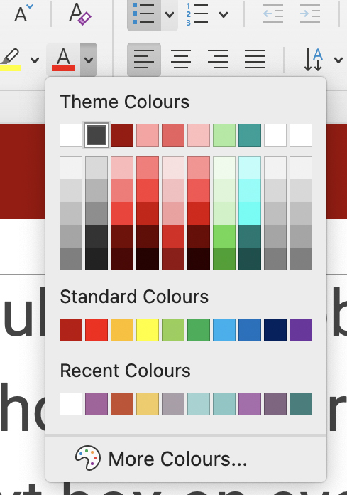
Content slide
For emphasis on words, as well as bold, use this red #A00202, use this red #ED5F5F. All colours are listed in the Spanish colour theme.
All items on the slide should use the ‘fade’ OR ‘appear’ animation – whichever you choose to use make sure it is consistently used within the subject – don’t mix the two. There should be something on the slide when the slide appears.
Subsequent items should appear on click in sensible chunks, and each item or chunk should convey a significant amount of info (i.e. not just an image).

Slide 5
Please use this style for speech bubbles.
Arrow style:
heading | heading | heading
text | text | text
text | text | text
text | text | text
text | text | text
Use format painter to apply this style to existing speech bubbles from older ppts.

Slide 6
End slide

